Slide 1
Sexual Abuse and Predator Prevention Protocol
Webinar Series 5 of 8
BROUGHT TO YOU BY
THE ASSOCIATION OF WALDORF SCHOOLS OF NORTH AMERICA
Notes:
Good Morning, Good Evening, Good Afternoon, ,…..to all of our attendees from literally across the globe.
This is the 5th of 8 webinars brought to you exclusively by the Association of Waldorf Schools of North America…My name is Sean Spellecy, I am the CEO of NewDawn Security, and I am your host for this series, And for those that are new to this webinar series….the purpose of this series to describe for you the verbal directions of exactly how we have been helping schools embed the Sexual Abuse and Sexual Predator Prevention protocols into their day to day operation and making sure they stay embedded.
NEXT SLIDE

Slide 2
Recap
Videos and PowerPoint Presentations:
http://school-security-consulting.com/
http://vimeopro.com/newdawnsecurity/association-of-waldorf-schools-of-north-america
Notes:
I want to recap from last week’s webinar on educating parents and students for just a short time,, discuss the survey you did , and make sure retrieving information provided in these series is as easy as possible. First and foremost, because one more time you have brought some great questions up after the webinar concluded II wanted to share the questions and the answers with you. The first question was can you provide some more information on how elementary students are educated? The second question was in reference to the Checklist for Conducting Student Sexual Assault Investigations at K-12 Schools, when should you notify law enforcement about an allegation? The short answer is, as soon as there was any hint of potential criminal misconduct. The long answer is, hopefully you have developed a relationship with your local police department so if your not sure as to whether or not there has been criminal misconduct, you can have an “off the record” conversation to determine your next steps.
Survey Results, 39 of you responded to the survey regarding whether or not to have a current Waldorf School Administrator speak to this group about how they are going about embedding these 8 protocols. 33 of you said Yes, 5 of you said you want more information, and one of you said no. So let me provide a little more information…
Now for document retrival of the videos and power point presentations
NEXT SLIDE

Slide 3
“BEHIND THE SCENES” ACTIONS FOR ADMINISTRATORS
Notes:
Today’s webinar focuses on the 5th^{h} of 8 needed embedded protocols, the elements of effective behind the scenes actions you can take to prevent or discover any current faculty, staff, volunteer, student, or parent committing any type of sexual abuse act on your campus….before we go any further…..who should be in the room and I apologize

Slide 4
ELEMENTS OF BEHIND THE
SCENES ACTIONS
Mindset
Unscheduled-Scheduled Drop In’s
Server Logs
Camera Search and Camera Placement
Anonymous Concern Reporting “System”
Incident and “Nurse” visit reports
Additional Characteristics
If you really suspect….
Notes:
Good manipulators (seduction is an integral part)
Overly self-indulgent
Arrogant
Sexualize, objectify women
Users of various kinds of pornography
Typically known as rationalizers, intellectualizers, justifiers
Great helpers — are there to lend a helping hand — prey on people in need, when they can insinuate themselves in your life
Use stressful and vulnerable situations to get in — they find a need they can fill and they use that to get next to the victim screen

Slide 5
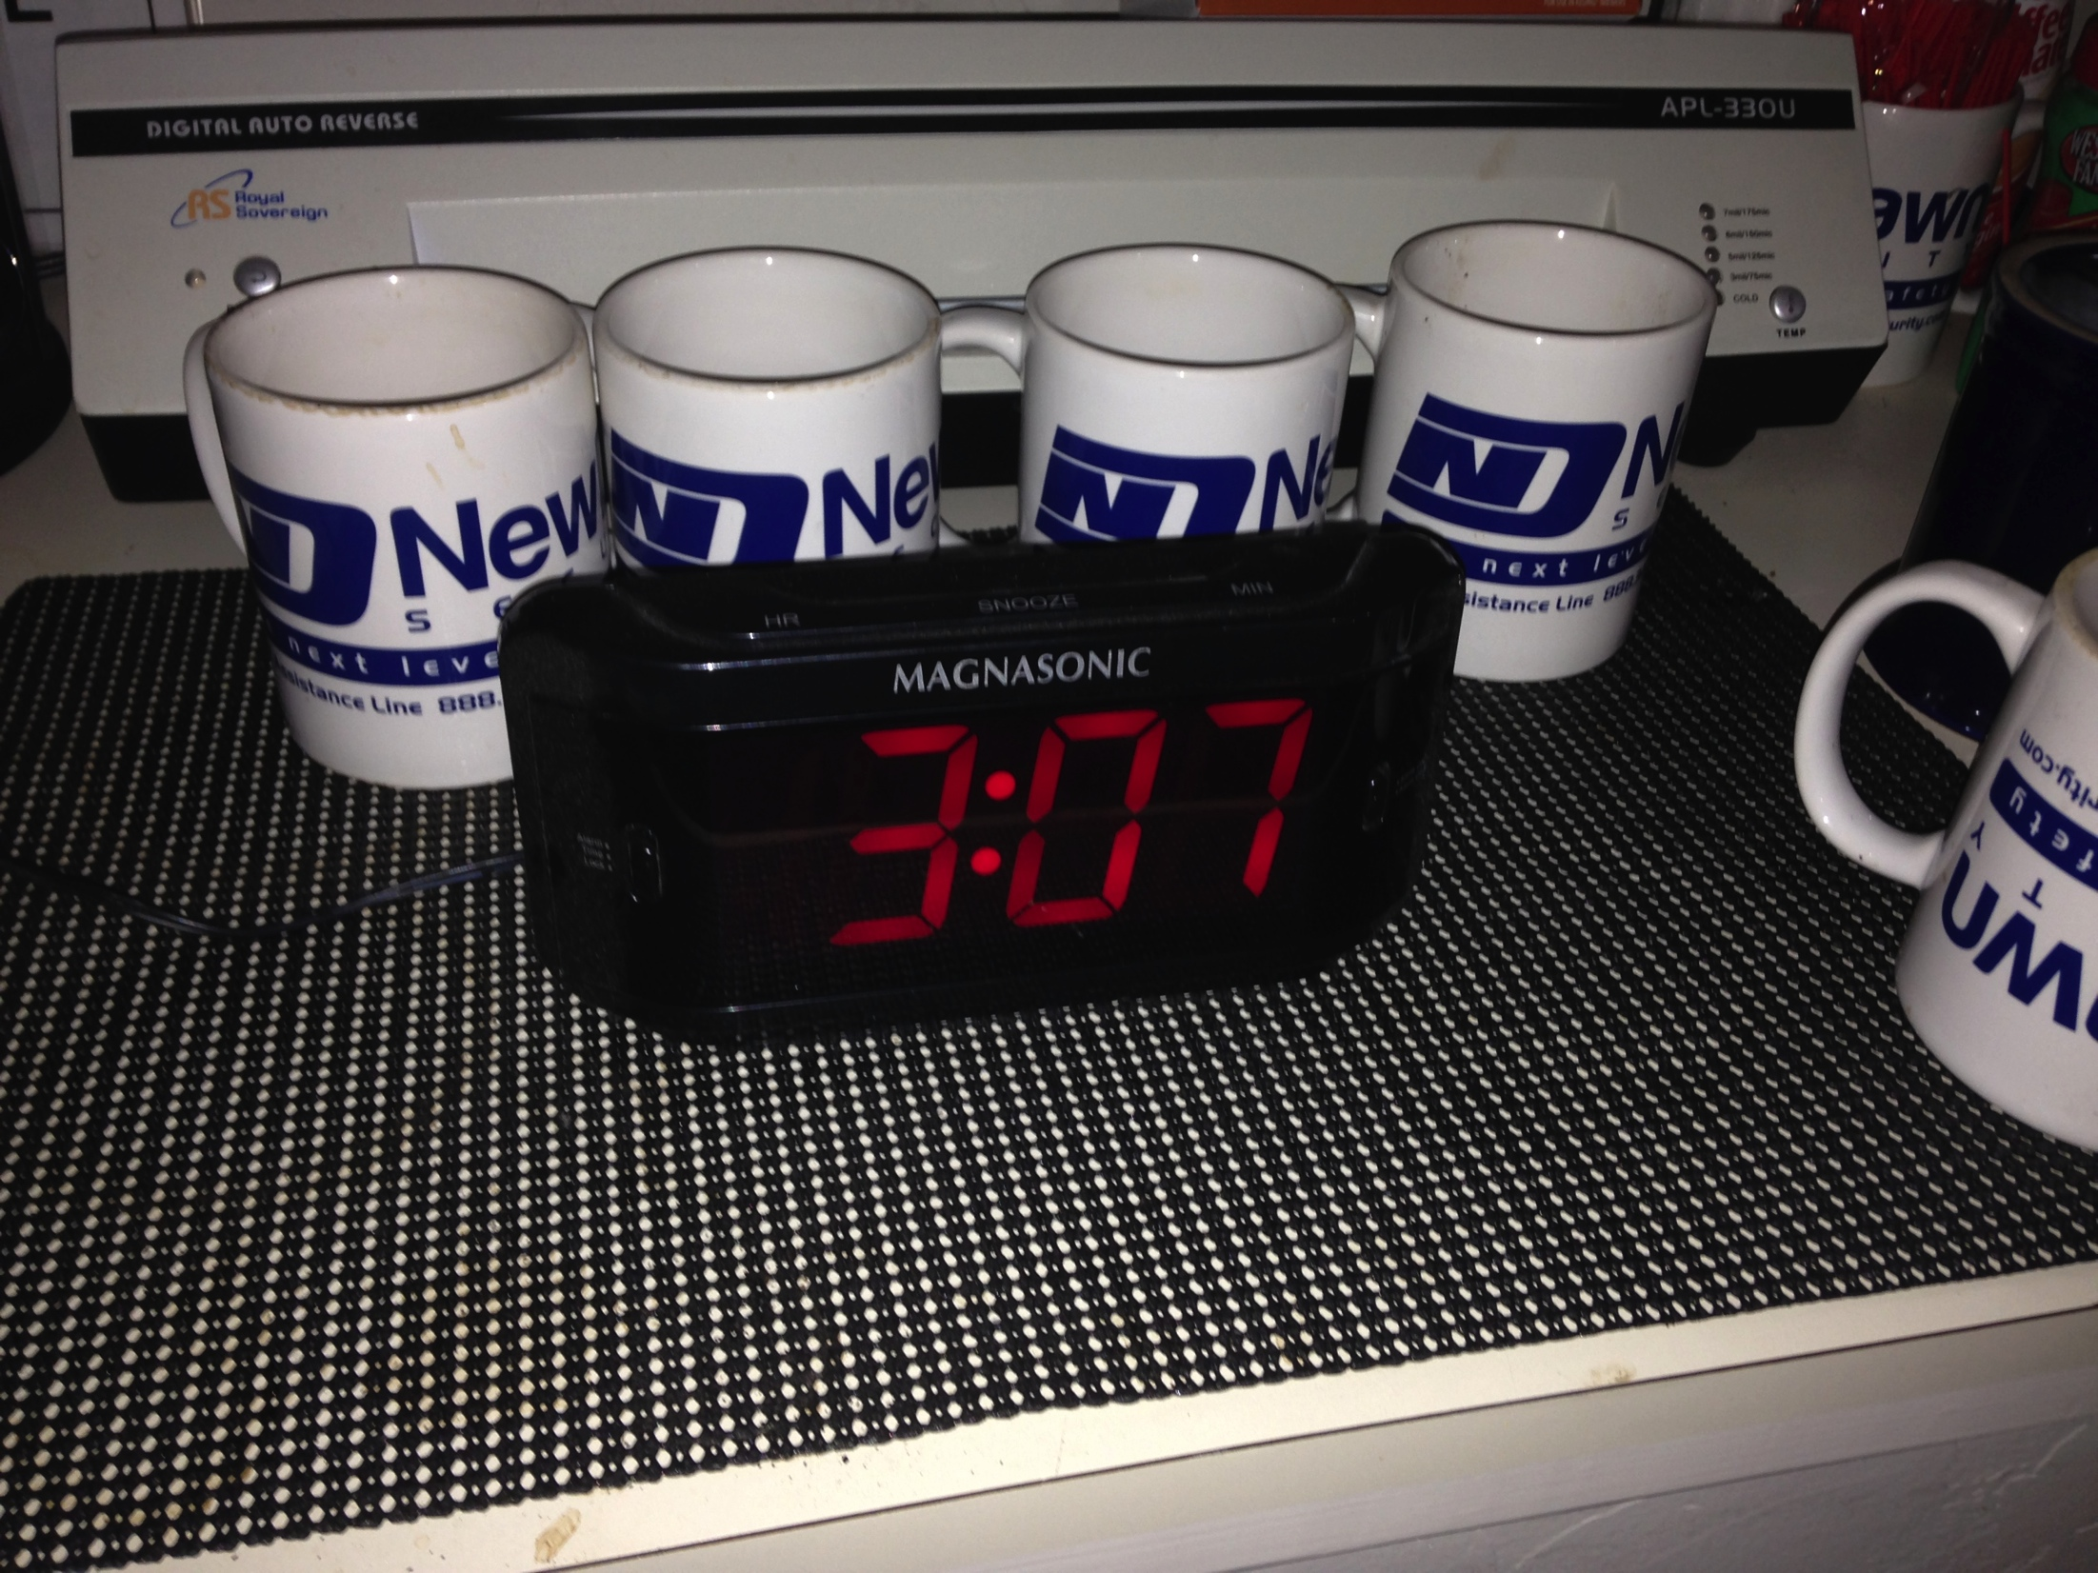
ELEMENTS OF BEHIND THE
SCENES ACTIONS
Notes:
Read from screen

Slide 6
QUESTIONS
Contact Info: Sean Spellecy: 888.267-6157 sean@newdawnsecurity.com
Document Link: http://school-security-consulting.com/
Notes:
We are getting close to our cut off time, if you have any specific questions about ths presentation, or how to implement that are not answered during this webinar please contact us.

Slide 7
SUMMARY
Contact Info: Sean Spellecy: 888.267-6157 sean@newdawnsecurity.com

Slide 8
UPCOMING WEBINARS
Session Five: October 14th, 2014 10:30 AM MDT:
Ensuring Sexual Predators Are Not Active on Campus
Session Five Link: https://attendee.gotowebinar.com/register/5713386035376085250
Session Six: October 21st, 2014 10:30 AM MDT
Preventing Outside Sexual Predators
Session Six Link: https://attendee.gotowebinar.com/register/2427678054697807873
Session Seven: October 28th, 2014 10:30 AM MDT
Proactive and Preventative Actions with 3rd Party Contractors
Session Seven Link: https://attendee.gotowebinar.com/register/2185668948354697729
Session Eight: November 14th, 2014 10:30 AM MDT
Recognizing Patterns of Behavior That Are Cause for Concern
Session Eight Link: https://attendee.gotowebinar.com/register/3037073578299891202

Slide 9
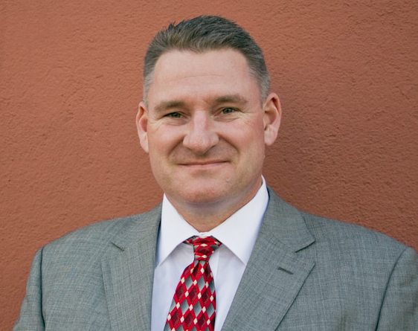
YOUR HOST
SEAN SPELLECY
SEAN SPELLECY: C.E.O. and Founder of NewDawn Security, 15 years of Security Experience,
10 years of Education Administration and Teaching Experience, Masters in ED.
Administration, Certified Protection Professional,
Association of Threat Assessment Professionals, Council Member A.S.I.S.
Nationwide School Safety and Security Council, School Violence Prevention
Council, and member of the Oregon School Safety and Security Officers
Association

Slide 10
RESEARCH
Protecting your Children From Sexual Predators, 2012, Dr. Leigh Baker
Protecting the Gift, 2008, Gavin DeBecker,
Identifying Child Molesters: Preventing Child Sexual Abuse by Recognizing the Patterns of Offenders, 2011, Dr. Carla Van Dam, Clinical and Forensic Psychology
The Socially Skilled Child Molester: Differentiating the Guilty From the Falsely Accused:
2011, Dr. Carla Van Dam, Clinical and Forensic Psychology
US Dept. of Juvenile Justice
US Dept. of Justice
National Sexual Violence Resource Center
Bureau of Justice Studies
31 Convicted Sexual Offender Interviews: Sean Spellecy 2006-2012

